Slide 1
Air Cargo Analysis

Slide 2
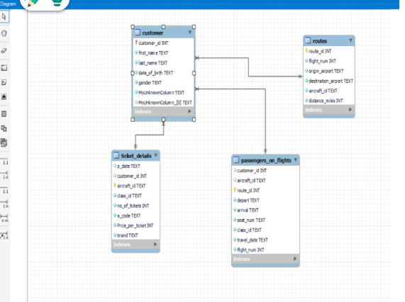
Create an ER diagram for the given airline's database.

Slide 3
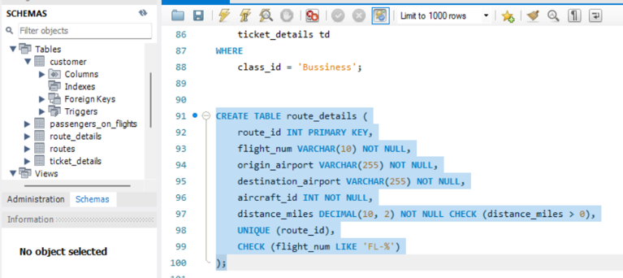
Write a query to create a route_details table using suitable data types for the fields, such as route_id, flight_num, origin_airport, destination_airport, aircraft_id, and distance_miles. Implement the check constraint for the flight number and unique constraint for the route_id fields. Also, make sure that the distance miles field is greater than 0
CREATE TABLE route_details (
route_id INT PRIMARY KEY,
Flight_num VARCHAR(10) NOT NULL,
origin_airport VARCHAR(255) NOT NULL,
destination_airport VARCHAR(255) NOT NULL,
aircraft_id INT NOT NULL,
distance_miles DECIMAL(10, 2) NOT NULL CHECK (distance_miles > 0),
UNIQUE (route_id),
CHECK (flight_num LIKE 'FL-%’)
);

Slide 4
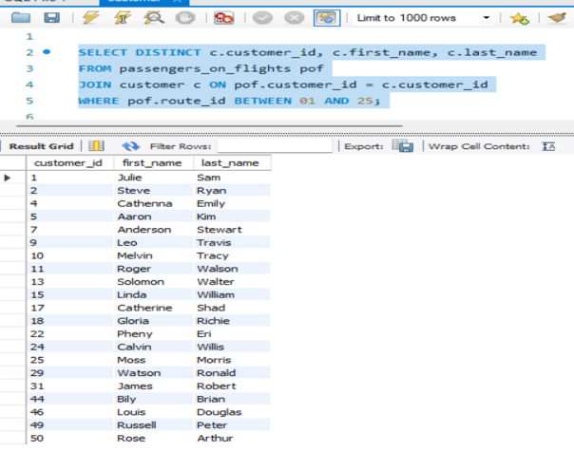
Write a query to display all the passengers (customers) who have traveled in routes 01 to 25. Take data from the passengers_on_flights table.
SELECT DISTINCT c.customer_id, c.first_name, c.last_name
FROM passengers_on_flights pof
JOIN customer c ON pof.customer_id = c.customer_id
WHERE pof.route_id BETWEEN 01 AND 25;

Slide 5
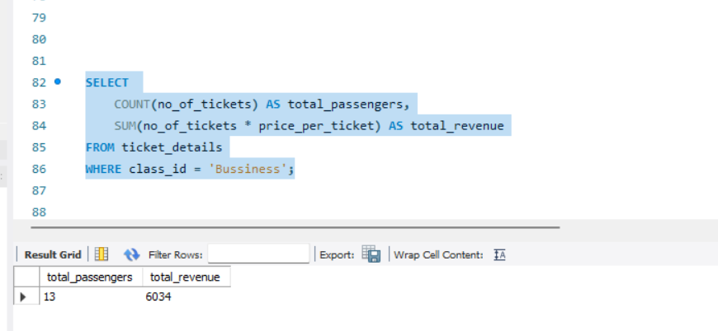
Write a query to identify the number of passengers and total revenue in business class from the ticket_details table.
SELECT COUNT(no_of_tickets) AS total_passengers, SUM(no_of_tickets * price_per_ticket) AS total_revenueFROM ticket_detailsWHERE class_id = 'Bussiness';

Slide 6
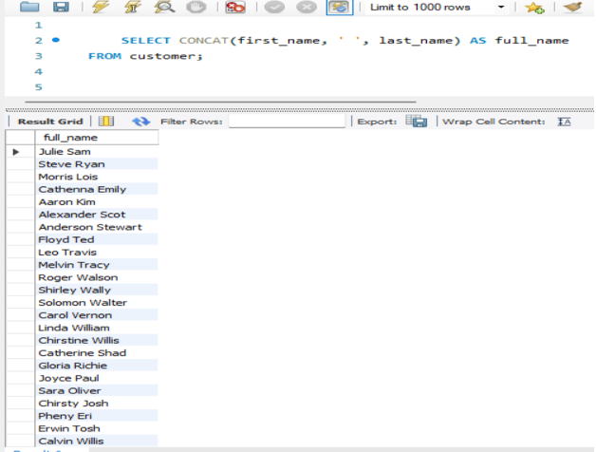
Write a query to display the full name of the customer by extracting the first name and last name from the customer table.
SELECT CONCAT(first_name, ' ', last_name) AS full_name
FROM customer;

Slide 7
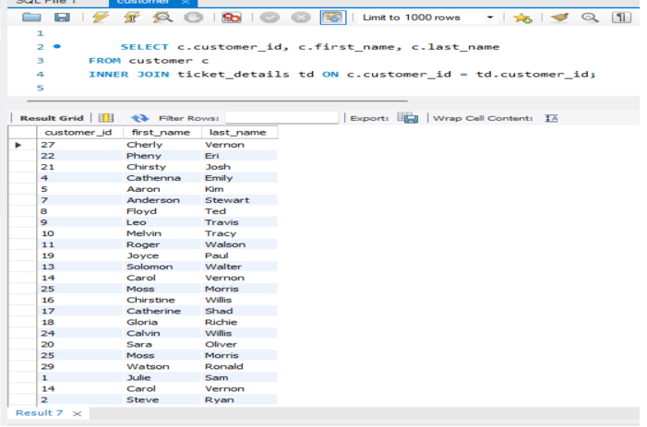
Write a query to extract the customers who have registered and booked a ticket. Use data from the customer and ticket_details tables.
SELECT c.customer_id, c.first_name, c.last_name
FROM customer c
INNER JOIN ticket_details td ON c.customer_id = td.customer_id;

Slide 8
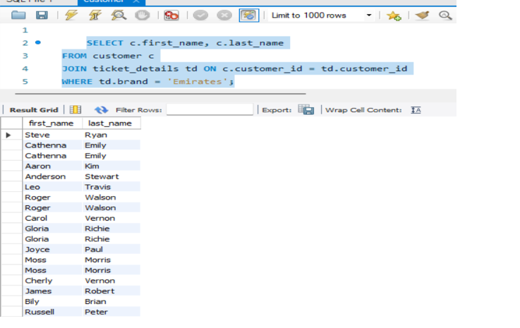
Write a query to identify the customer’s first name and last name based on their customer ID and brand (Emirates) from the ticket_details table.
SELECT c.first_name, c.last_name
FROM customer c
JOIN ticket_details td ON c.customer_id = td.customer_id
WHERE td.brand = 'Emirates';

Slide 9
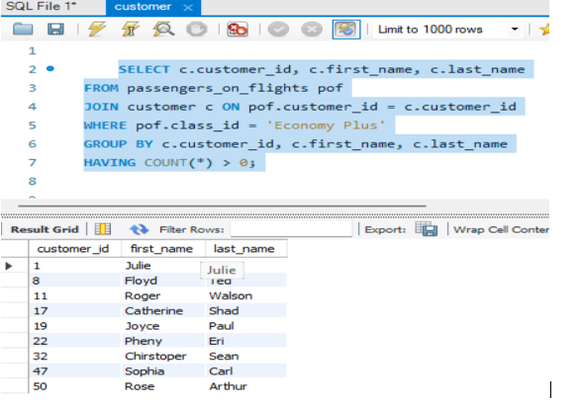
Write a query to identify the customers who have travelled by Economy Plus class using Group By and Having clause on the passengers_on_flights table.
SELECT c.customer_id, c.first_name, c.last_name
FROM passengers_on_flights pof
JOIN customer c ON pof.customer_id = c.customer_id
WHERE pof.class_id = 'Economy Plus'
GROUP BY c.customer_id, c.first_name, c.last_name
HAVING COUNT(*) > 0;

Slide 10
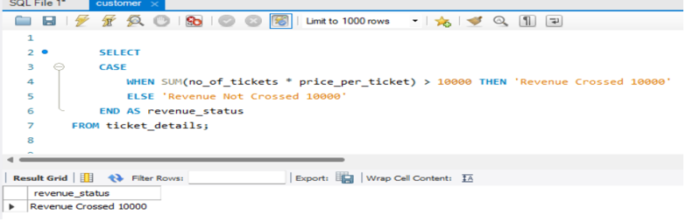
Write a query to identify whether the revenue has crossed 10000 using the IF clause on the ticket_details table.
SELECT
CASE
WHEN SUM(no_of_tickets * price_per_ticket) > 10000 THEN 'Revenue Crossed 10000'
ELSE 'Revenue Not Crossed 10000'
END AS revenue_status
FROM ticket_details;

Slide 11
Write a query to create and grant access to a new user to perform operations on a database
-- Create a new user with a password
CREATE USER 'JACK'@'LOCALHOST' IDENTIFIED BY 'Jack@123';
-- grant permission to the new user
GRANT SELECT, INSERT, UPDATE, DELETE ON airlines.* TO 'JACK'@'LOCALHOST';

Slide 12
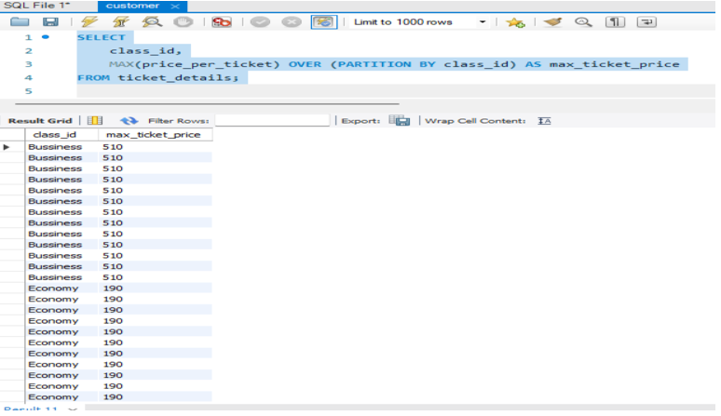
Write a query to find the maximum ticket price for each class using window functions on the ticket_details table.
SELECT
class_id,
MAX(price_per_ticket) OVER (PARTITION BY class_id) AS max_ticket_price
FROM ticket_details;

Slide 13
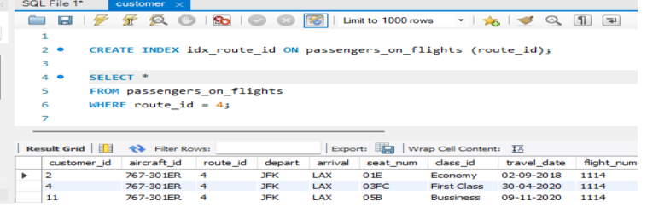
Write a query to extract the passengers whose route ID is 4 by improving the speed and performance of the passengers_on_flights table.
CREATE INDEX idx_route_id ON passengers_on_flights (route_id);
SELECT *
FROM passengers_on_flights
WHERE route_id = 4;

Slide 14
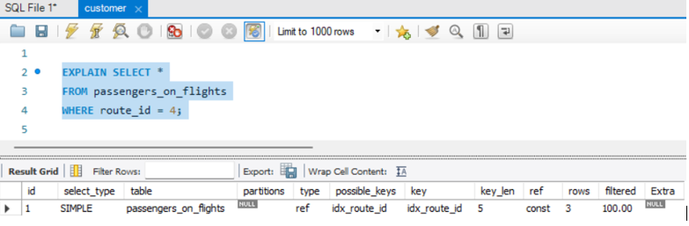
For route ID 4, write a query to view the execution plan of the passengers_on_flights table.
EXPLAIN SELECT *
FROM passengers_on_flights
WHERE route_id = 4;

Slide 15
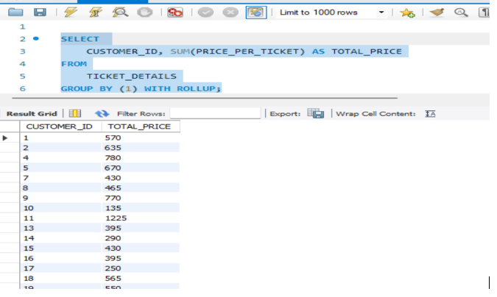
Write a query to calculate the total price of all tickets booked by a customer across different aircraft IDs using rollup function.
SELECT
CUSTOMER_ID, SUM(PRICE_PER_TICKET) AS TOTAL_PRICE
FROM
TICKET_DETAILS
GROUP BY (1) WITH ROLLUP;

Slide 16
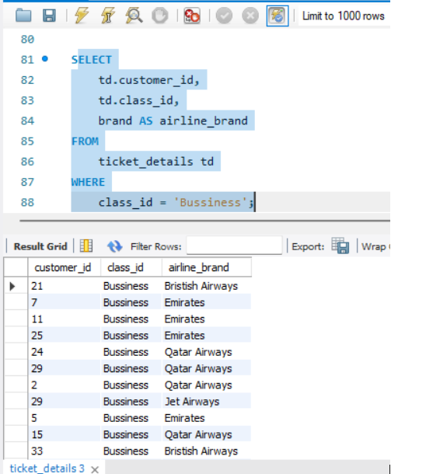
Write a query to create a view with only business class customers along with the brand of airlines.
SELECT
td.customer_id,
td.class_id,
brand AS airline_brand
FROM
ticket_details td
WHERE
class_id = 'Bussiness';

Slide 17
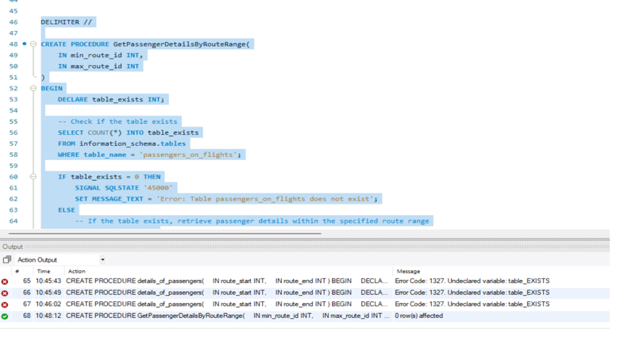
Write a query to create a stored procedure to get the details of all passengers flying between a range of routes defined in run time. Also, return an error message if the table doesn't exist.
DELIMITER //
CREATE PROCEDURE GetPassengerDetailsByRouteRange(
IN min_route_id INT,
IN max_route_id INT)
BEGIN DECLARE table_exists INT;
-- Check if the table exists
SELECT COUNT(*) INTO table_exists
FROM information_schema.tables
WHERE table_name = 'passengers_on_flights';
IF table_exists = 0 THEN
SIGNAL SQLSTATE '45000'
SET MESSAGE_TEXT = 'Error: Table passengers_on_flights does not exist';
ELSE
-- If the table exists, retrieve passenger details within the specified route range
SET @sql = CONCAT('
SELECT *
FROM passengers_on_flights
WHERE route_id BETWEEN ', min_route_id, ' AND ', max_route_id);
PREPARE stmt FROM @sql;
EXECUTE stmt;
DEALLOCATE PREPARE stmt;
END IF;
END //
DELIMITER ;

Slide 18
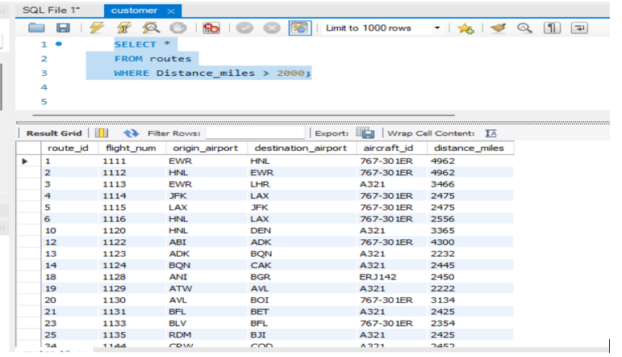
Write a query to create a stored procedure that extracts all the details from the routes table where the traveled distance is more than 2000 miles.
SELECT *
FROM routes
WHERE Distance_miles > 2000;

Slide 19
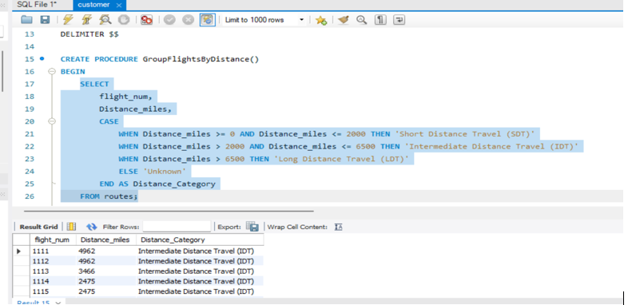
Write a query to create a stored procedure that groups the distance traveled by each flight into three categories. The categories are, short distance travel (SDT) for >=0 AND <= 2000 miles, intermediate distance travel (IDT) for >2000 AND <=6500, and long-distance travel (LDT) for >6500.
SELECT
flight_num,
Distance_miles,
CASE
WHEN Distance_miles >= 0 AND Distance_miles <= 2000 THEN 'Short Distance Travel (SDT)'
WHEN Distance_miles > 2000 AND Distance_miles <= 6500 THEN 'Intermediate Distance Travel (IDT)'
WHEN Distance_miles > 6500 THEN 'Long Distance Travel (LDT)'
ELSE 'Unknown'
END AS Distance_Category
FROM routes;

Slide 20
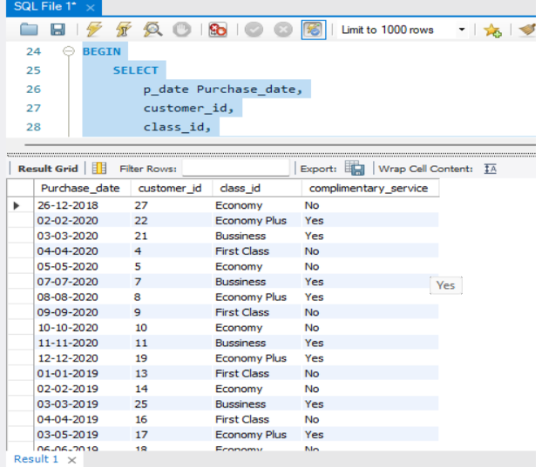
Write a query to extract ticket purchase date, customer ID, class ID and specify if the complimentary services are provided for the specific class using a stored function in stored procedure on the ticket_details table.
DELIMITER //
drop function if exists IsComplimentaryService;
CREATE FUNCTION IsComplimentaryService(class_id VARCHAR(50)) RETURNS VARCHAR(3) deterministic
BEGIN DECLARE result VARCHAR(3);
IF class_id = 'Bussiness' OR class_id = 'Economy Plus' THEN SET result = 'Yes';
ELSE SET result = 'No';
END IF;
RETURN result;
END;
//
DELIMITER ;
DELIMITER //
drop procedure if exists GetTicketDetailsWithComplimentaryService;
CREATE PROCEDURE GetTicketDetailsWithComplimentaryService()
BEGIN
SELECT p_date Purchase_date, customer_id, class_id,
IsComplimentaryService(class_id) AS complimentary_service
FROM ticket_details;
END;
//
DELIMITER ;
CALL GetTicketDetailsWithComplimentaryService();

Slide 21
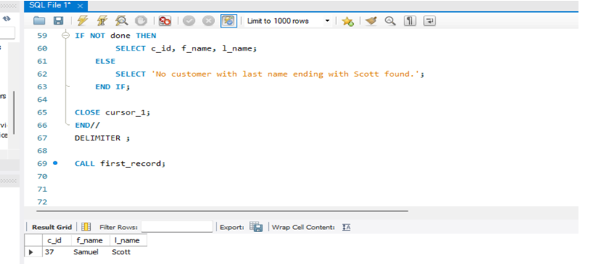
Write a query to extract the first record of the customer whose last name ends with Scott using a cursor from the customer table.
DELIMITER // CREATE PROCEDURE first_record() BEGIN DECLARE done INT DEFAULT 0; DECLARE c_id INT; DECLARE f_name VARCHAR(50); DECLARE l_name VARCHAR(50); DECLARE cursor_1 CURSOR FOR SELECT customer_id, first_name, last_name FROM customer WHERE last_name LIKE '%Scott' LIMIT 1; DECLARE CONTINUE HANDLER FOR NOT FOUND SET done = 1; OPEN cursor_1; FETCH cursor_1 INTO c_id, f_name, l_name; IF NOT done THEN SELECT c_id, f_name, l_name; ELSE SELECT 'No customer with last name ending with Scott found.'; END IF; CLOSE cursor_1; END// DELIMITER ; CALL first_record;

